Slide 1
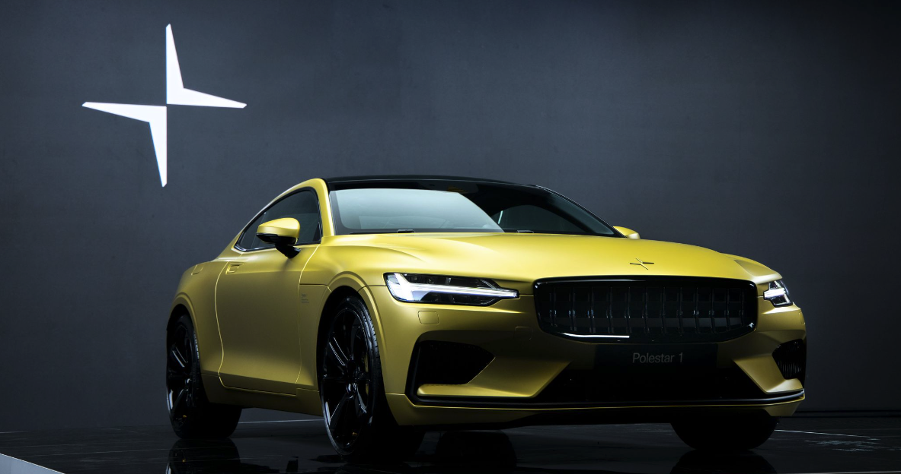
Predicting Polestar Success
Using data analysis of TESLA stock
to determine Polestar success
Notes:
We represent Polestar, an up-and-coming electric vehicle that went public in June 2022.

Slide 2










Overview
Purpose of Project:
Determine whether stock performance of electric vehicles can predict stock performance of Polestar.
Questions to Answer:
Can historical stock prices from other electrical vehicles predict growth of Polestar?
How well suited are we to be competitive in the market?
Faraday Future
Team:
Tracey Fitzpatrick
Cheryl Farnsworth
Kelly Nichols
Holly Smith
Notes:
Our team wondered whether historical stock prices from other electric vehicles (EV) could predict growth of this recent addition to the market.

Slide 3

Faraday Future
Notes:
THROWAWAY SLIDE

Slide 4
Data
Datasets
StockAnalysis.com for a list of IPOS launched in the last recession 2008.
Kaggle for a list of US Company information on these IPOS.
API of historical pricing data to train our model for future price predictions using volume as a predictor.
Outputs

Slide 5
Technologies Used
Tableau
pandas
Notes:
https://cleantechnica.com/2022/07/17/polestar-3-pricing-revealed-are-you-sitting-down/ : “Polestar, the all-electric brand from Volvo Cars [starts at $47,200] is taking direct aim at the Porsche Cayenne [starts at $150,000] in its bid to become a major manufacturer of electric automobiles.”

Slide 6
Data Exploration
These are stand-in pictures.
Must be updated.
Notes:
Can I use what’s in the README?

Slide 7
Analysis
Random forest classifier
We want to maximize our true positives - days when the algorithm predicts that
the price will go up, and it actually goes go up. Therefore, we'll be using precision
as our error metric for our algorithm, which is true positives / (false positives +
true positives). If we were investing, this will ensure that we minimize how much
money we lose with false positives, days when we buy the stock, but the price
actually goes down.

Slide 8
Results
If Polestar would like to be at the same level as Telsa, they would need to add additional businesses and marketing like Tesla who has tremendous brand recognition in the industry. However, if they would like to stick with EV vehicles only, like the other EV companies, they have a good chance at share prices rising to the same level as your average EV company. Of course, other considerations would need to be made.

Slide 9
Dashboard
EV & Future Transporta-- tion Model – 1 Month
NASDAQ
Placeholder for stock ticker tape
Chart from Data Analysis
Data Analysis Info

Slide 10
Recommendations

Slide 11
What the team would have done differently

Slide 12
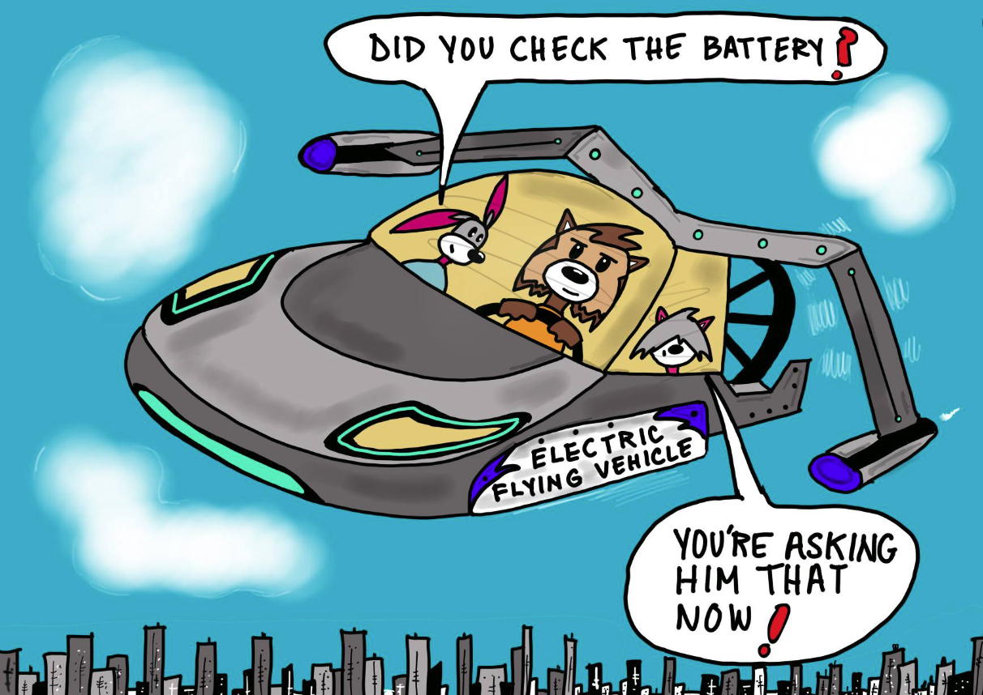

Slide 13
